Slide 1
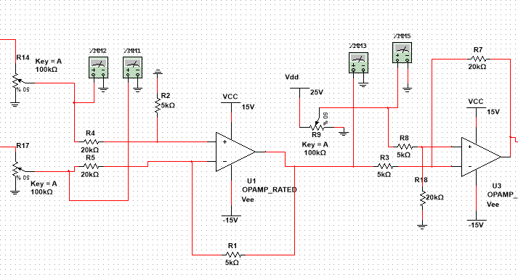
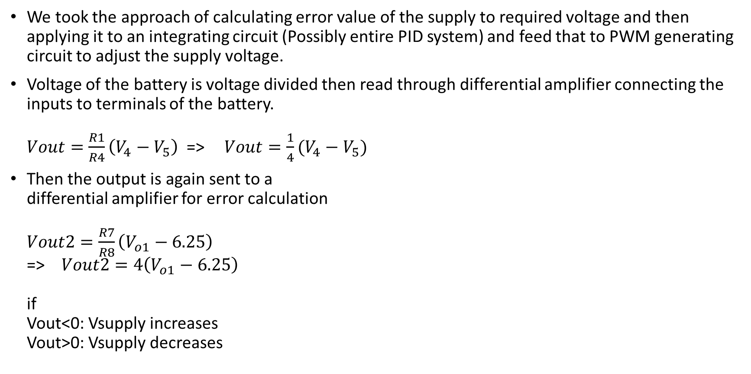
Constant voltage control
We took the approach of calculating error value of the supply to required voltage and then applying it to an integrating circuit (Possibly entire PID system) and feed that to PWM generating circuit to adjust the supply voltage.
Voltage of the battery is voltage divided then read through differential amplifier connecting the inputs to terminals of the battery. $Vout=\frac{R1}{R4}\left(V_{4}−V_{5}\right)$=>$Vout=\frac{1}{4}(V_{4}−V_{5})$
Then the output is again sent to a differential amplifier for error calculation $Vout2=\frac{R7}{R8}\left(V_{o1}−6.25\right)$ => $Vout2=4\left(V_{o1}−6.25\right)$ if Vout<0: Vsupply increases Vout>0: Vsupply decreases

Slide 2
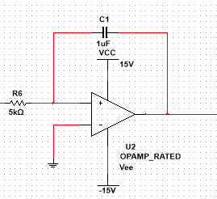
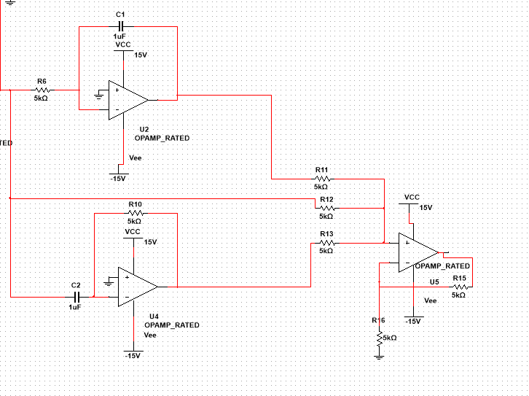
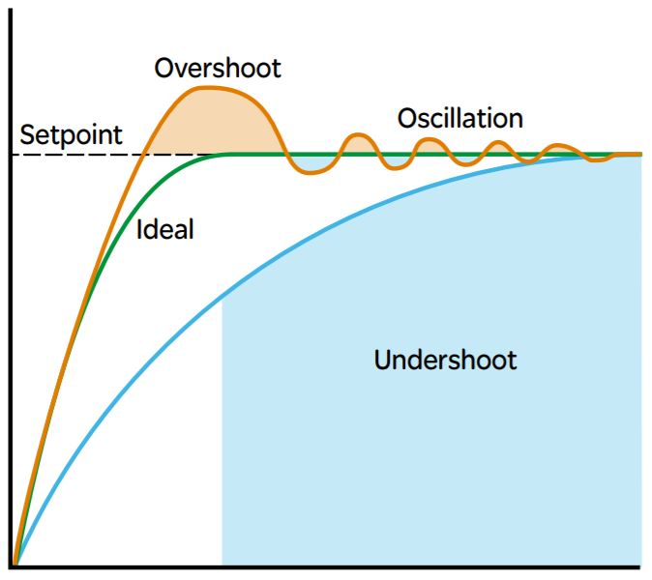

Lastly the error value will be sent to an integrator circuit. To update the current value to the circuit. $Vout3=\frac{−1}{R6∗C1}\int_{0}^{t}{V_{02} d}$t ;accumulation of error values
Consideration of PID instead of just integrator. By using this system, we could reduce the oscillation overshooting and achieve result faster.

